Slide 1
APAS Ariel Performance Analysis System
Installation Instructions

Slide 2
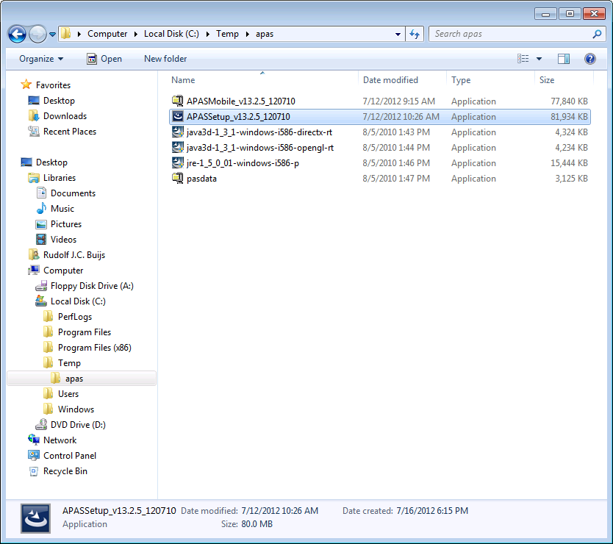
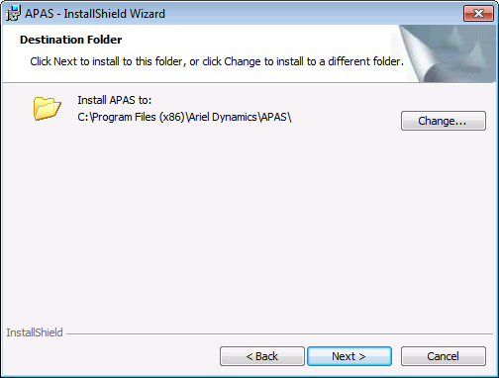
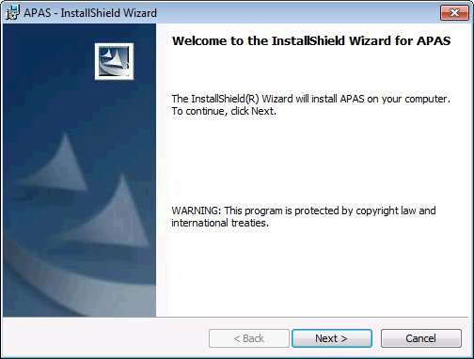
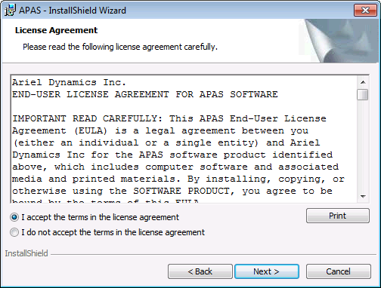
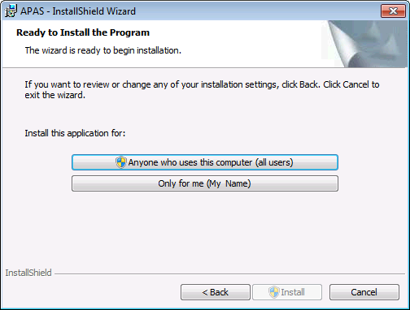
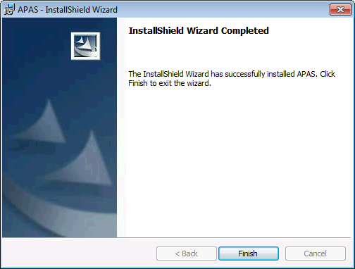
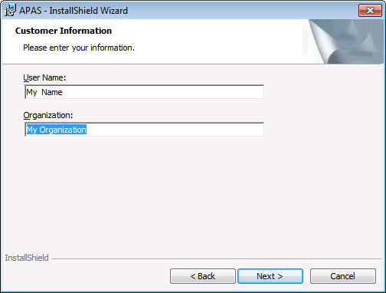
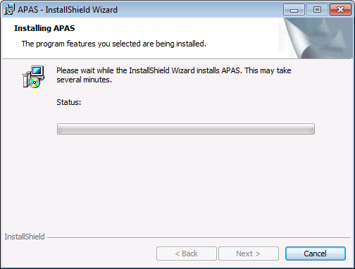
APAS – Installation of System Software
Step 1
Execute APASSetup_<version>.exe
Step 2
Select preferred Destination Folder
Step 3
Follow instructions on your screen
Step 4
Finished!
Step 5
Start APAS

Slide 3
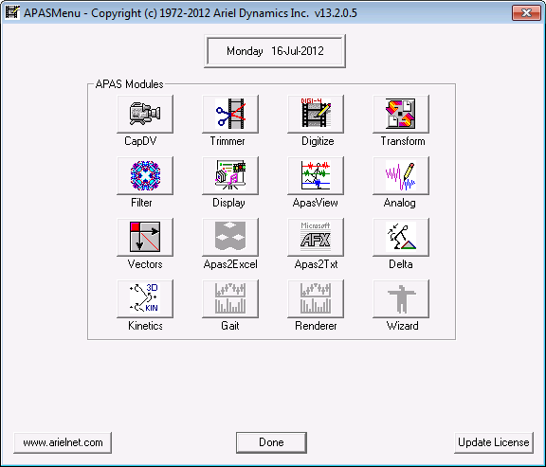
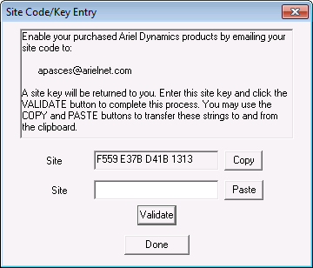
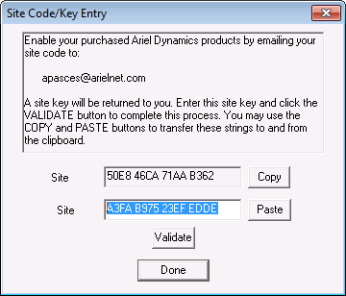
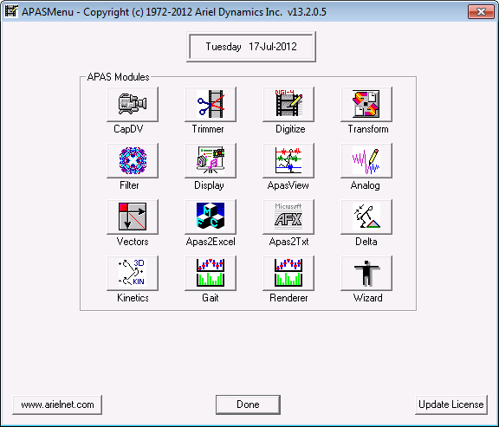
APAS – Activate your License
Step 1
Start APAS
Step 2
Select Update License
Step 3
Select Copy and send code
to apasces@arielnet.com
Step 4
Receive your
Site Key
by email and
copy to clipboard
Step 5
Select Paste, then Validate
Step 6
Verify your apps are active

Slide 4
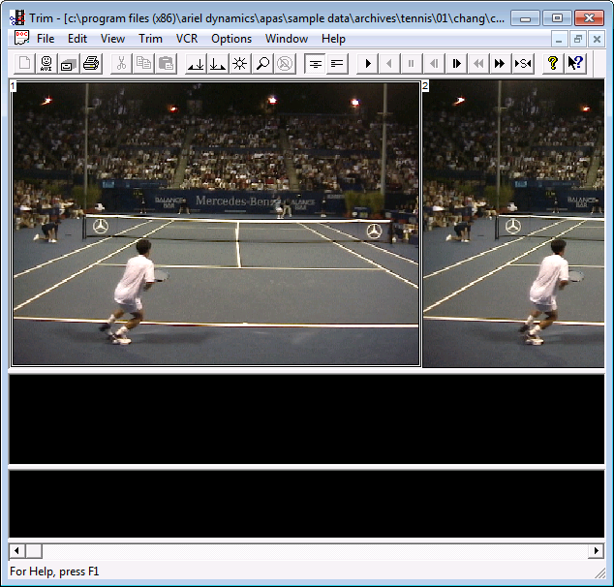
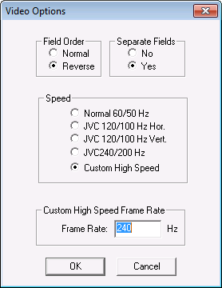
APAS – Set Custom High Speed Frame Rate
Step 1
Start APAS/Trimmer
Step 2
Open a high-speed video file and choose Options > Video
Step 3
Set Custom High Speed
Frame Rate

Slide 5
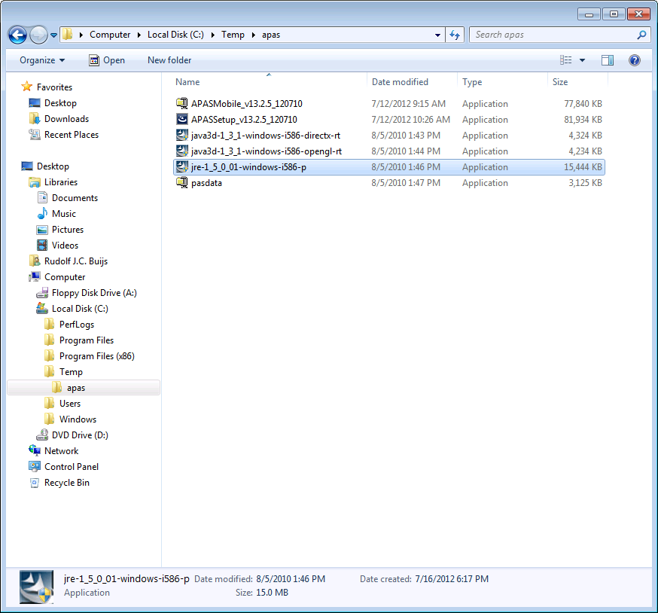
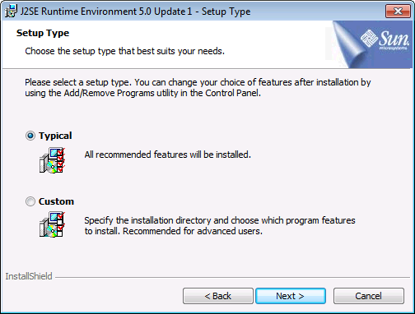
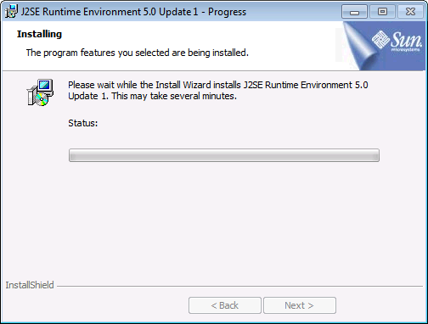
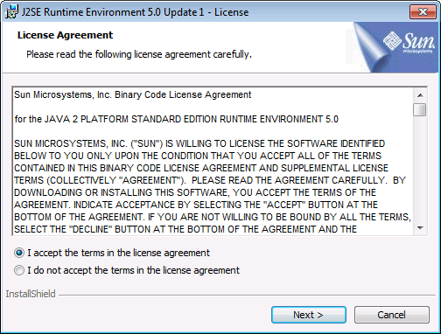
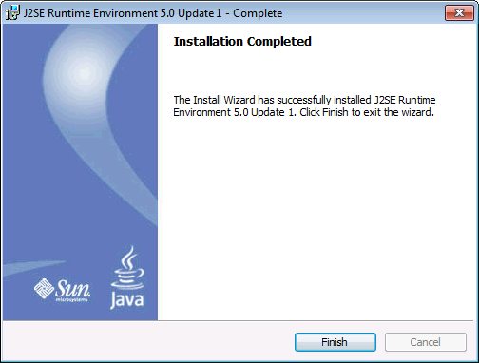
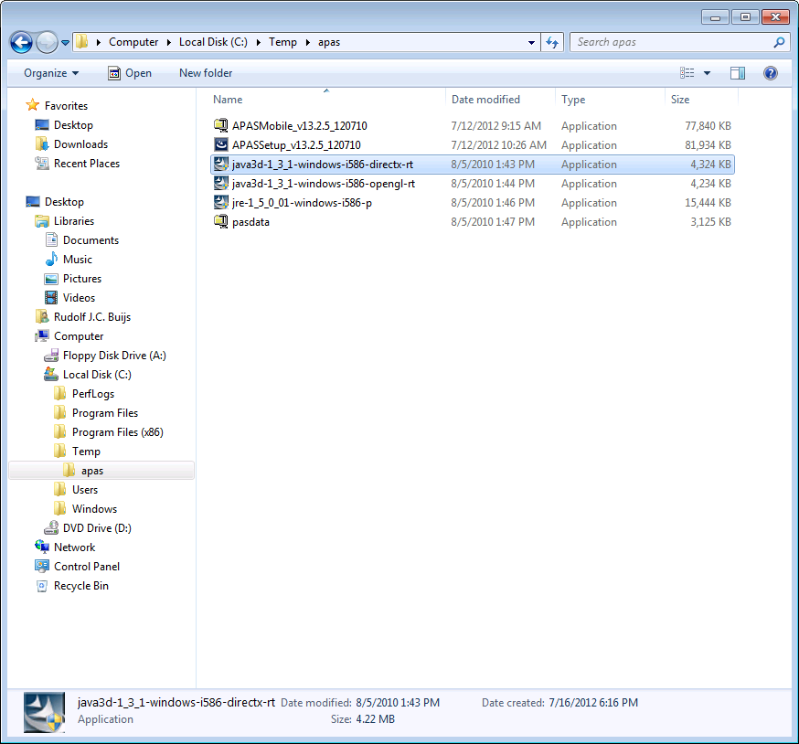
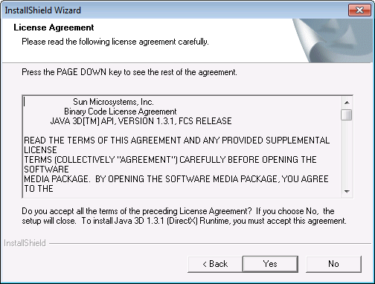
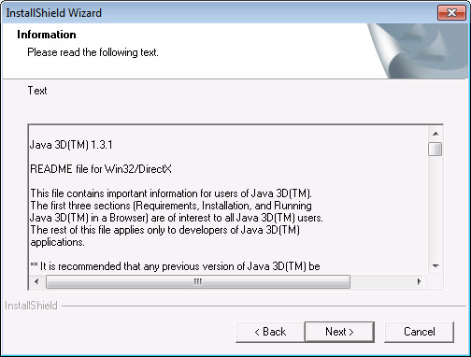
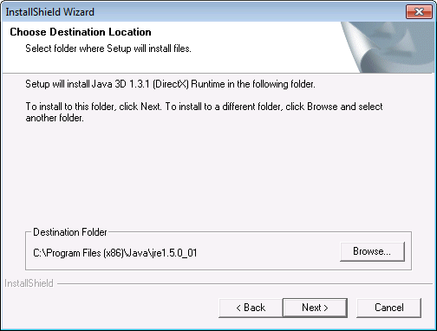
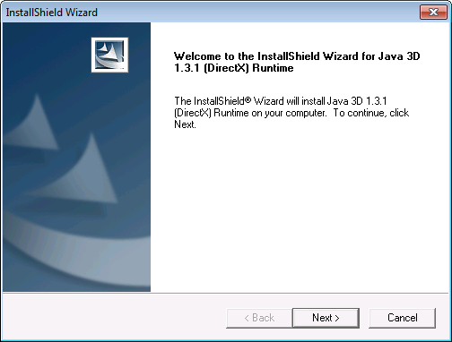
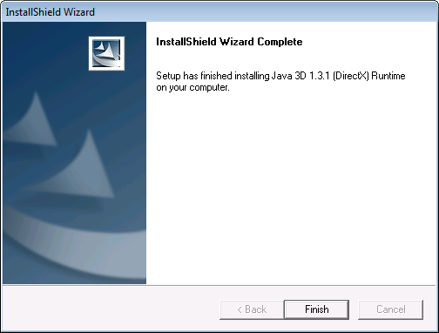
APAS – Prerequisites APAS/Gait & APAS/Renderer
Step 1
Execute jre-1_5_0_01-windows-i586-p.exe
Step 2
Follow the instructions on your screen
Step 3
Execute java3d-1_3_1-windows-i586-directx-rt.exe
Step 4
Follow the instructions on your screen

Slide 6
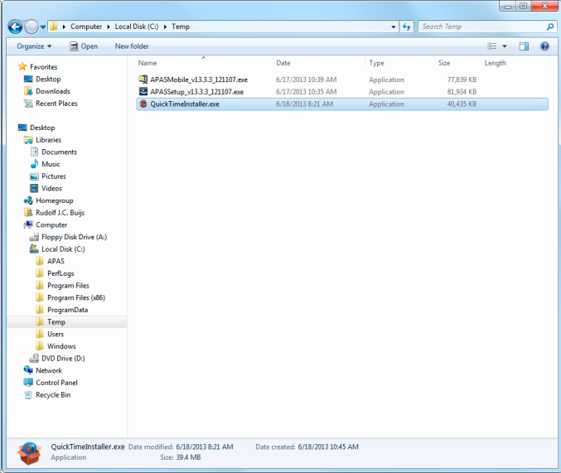
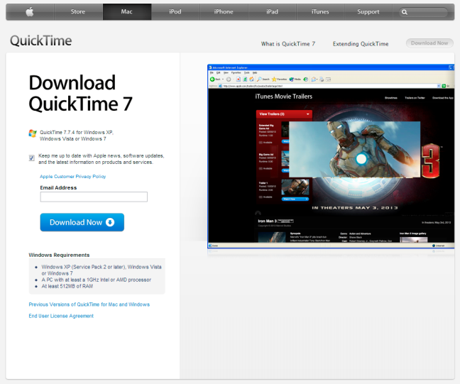
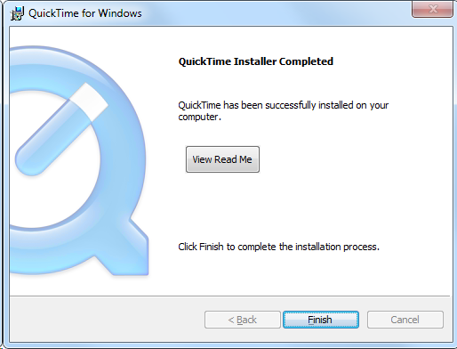
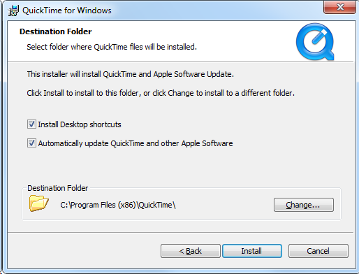
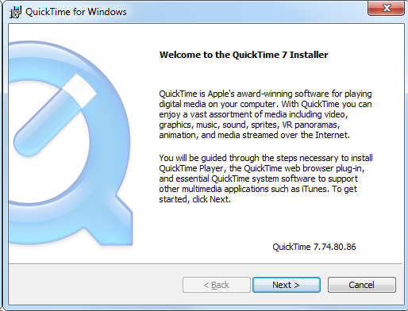
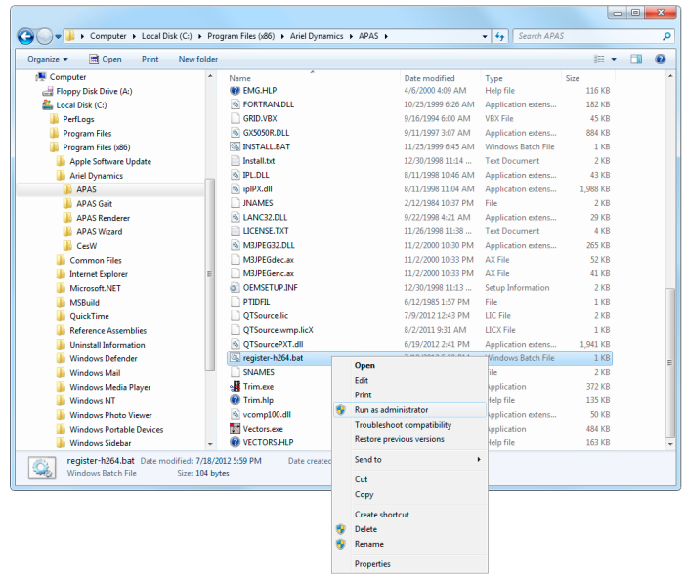
APAS – Prerequisites H.264/MPEG-4 AVC Video
Step 1
Download Apple QuickTime from:
www.apple.com/quicktime/download
Step 2
Install Apple QuickTime
Step 3
Only for APAS/Mobile
Locate the file register-h264.bat
And modify it:
echo off
echo "registering..."
regsvr32.exe "%~dp0\QTSourcePXT.dll“
Right-click and select Run as administrator
Step 4
Only for APAS/Mobile

